Slide 1


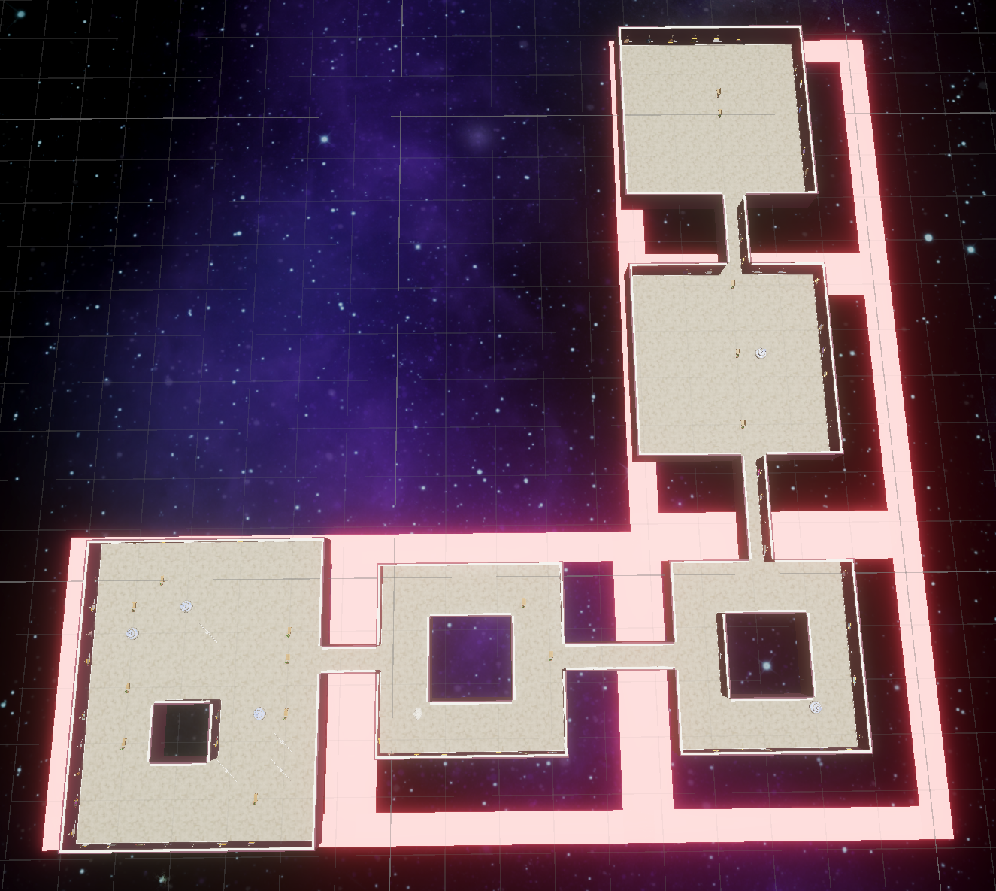
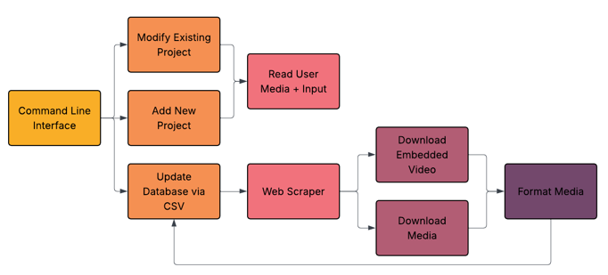
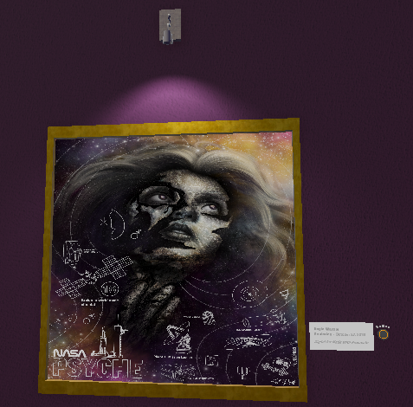
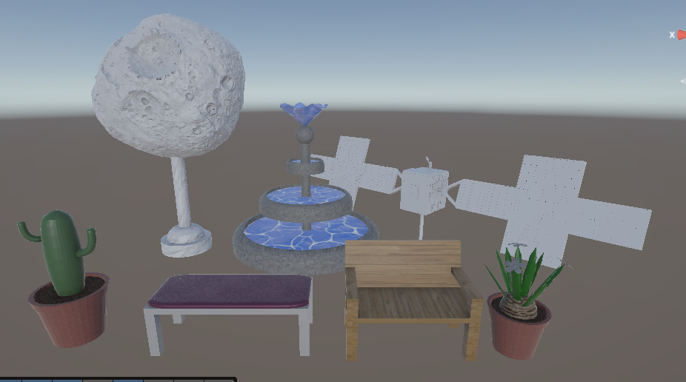
Virtual Reality Psyche Inspired Art and Artists Showcase
Project Overview
On October 13th, 2023, NASA launched a space probe destined for the Psyche asteroid. This probe, also named Psyche, will orbit the asteroid to take measurements that could provide insights into the formation of Earth itself. As part of Psyche Inspired, the mission’s public outreach program, classes of students from numerous universities over the years have created art projects in diverse media expressing what the Psyche mission means to them.
Some of these art projects have been displayed in various local museums or on the ASU campus for short periods of time. However, there has never been a physical museum experience showcasing every Psyche Inspired art piece in one place. While all of the art pieces are available to view on the Psyche website, this does not give the same feeling of being in a museum. Our team’s goal was to create a virtual reality museum that gave viewers the chance to experience Psyche Inspired art in the immersive museum setting that it deserves.
Web Scraper
The media files for all Psyche Inspired projects are hosted on the online Psyche Artwork Gallery. Each project file must be downloaded and stored locally in order to appear in the museum. Our team created a spreadsheet that stores the information about each project (title, artist, medium, etc.) as well as the link to the project’s page within Psyche's online gallery. Our software analyzes the spreadsheet and uses our web scraper, which visits the webpage and downloads all media attached to a project, whether that be an image, a YouTube video, a gif, or something else. It then stores these media files along with their associated project information in a local SQLite database. This database creator/updater has been containerized using Docker for ease of use. Once this database has been populated, the Unity VR program is able to read from the database and populate art frames on the museum walls with the project's media, whatever filetype that might be.
Museum Layout Generation
Every time a new user enters the museum, an entirely fresh museum layout is generated, given some number of artworks to display. The algorithm snakes through a grid and determines where rooms will be and to which rooms they will connect. Then, spread out along the walls, art displays (see Artwork Display) are populated with random art from our database. As a final step, to give the museum some flair, we add in fun decorations that our team has produced. Once all these steps are completed, the user is free to explore their uniquely generated museum!
System Architecture
Internally, the system is divided up into three main systems that all talk to each other. These are the Museum Layout Generator, the Artwork Displays, and the Database Middleware. During normal operation, the system follows a pattern of first having the Museum Layout Generator create a layout, which then sends the populate signal to the Artwork Displays, which individually request artwork from the Database Middleware, which reads from the database generated by the Web Scraper. Each of these major systems rely on each other to fully build out and populate a new museum, but are still fairly independent in their function.
Figure 1: Activity flow diagram illustrating how the web scraper collects, processes, and stores artwork data into the internal database.
Figure 3: Visualization of generated Room Chunks. Each room is connected to the next in a snake-like pattern, and each room is confined to its own chunk.
Artwork Display
Each piece of artwork is displayed in high definition, with the artist’s Name, Major, Genre, Date of Creation, and a small description of the art piece. Clicking the small button to the right of the display brings out the full description of the art piece.
Each tour of the museum contains a curated selection of displays from the database, providing each user their own unique set of art pieces. Videos and music automatically play when you approach the display, allowing you to enjoy them in their entirety.
This work was created in partial fulfillment of ASU Capstone Course SER401/402. The work is a result of the Psyche Student Collaborations component of NASA’s Psyche Mission (https://psyche.ssl.berkeley.edu). “Psyche: A Journey to a Metal World” [Contract number NNM16AA09C] is part of the NASA Discovery Program mission to solar system targets. Trade names and trademarks of ASU and NASA are used in this work for identification only. Their usage does not constitute an official endorsement, either expressed or implied, by Arizona State University or National Aeronautics and Space Administration. The content is solely the responsibility of the authors and does not necessarily represent the official views of ASU or NASA.
Figure 2: An art frame from the museum showing one of the Psyche Inspired art projects. The artist information is shown on a plaque to the right of the frame. Pressing a button next to the plaque will expand the plaque to show the full artist’s description. A small light above the frame illuminates the frame with mood lighting.
Figure 4: These decorations randomly populate empty spaces in the museum, making it feel more vivid. A checking algorithm ensures that identical decorations do not appear in twice in the same room.

